Slide 1
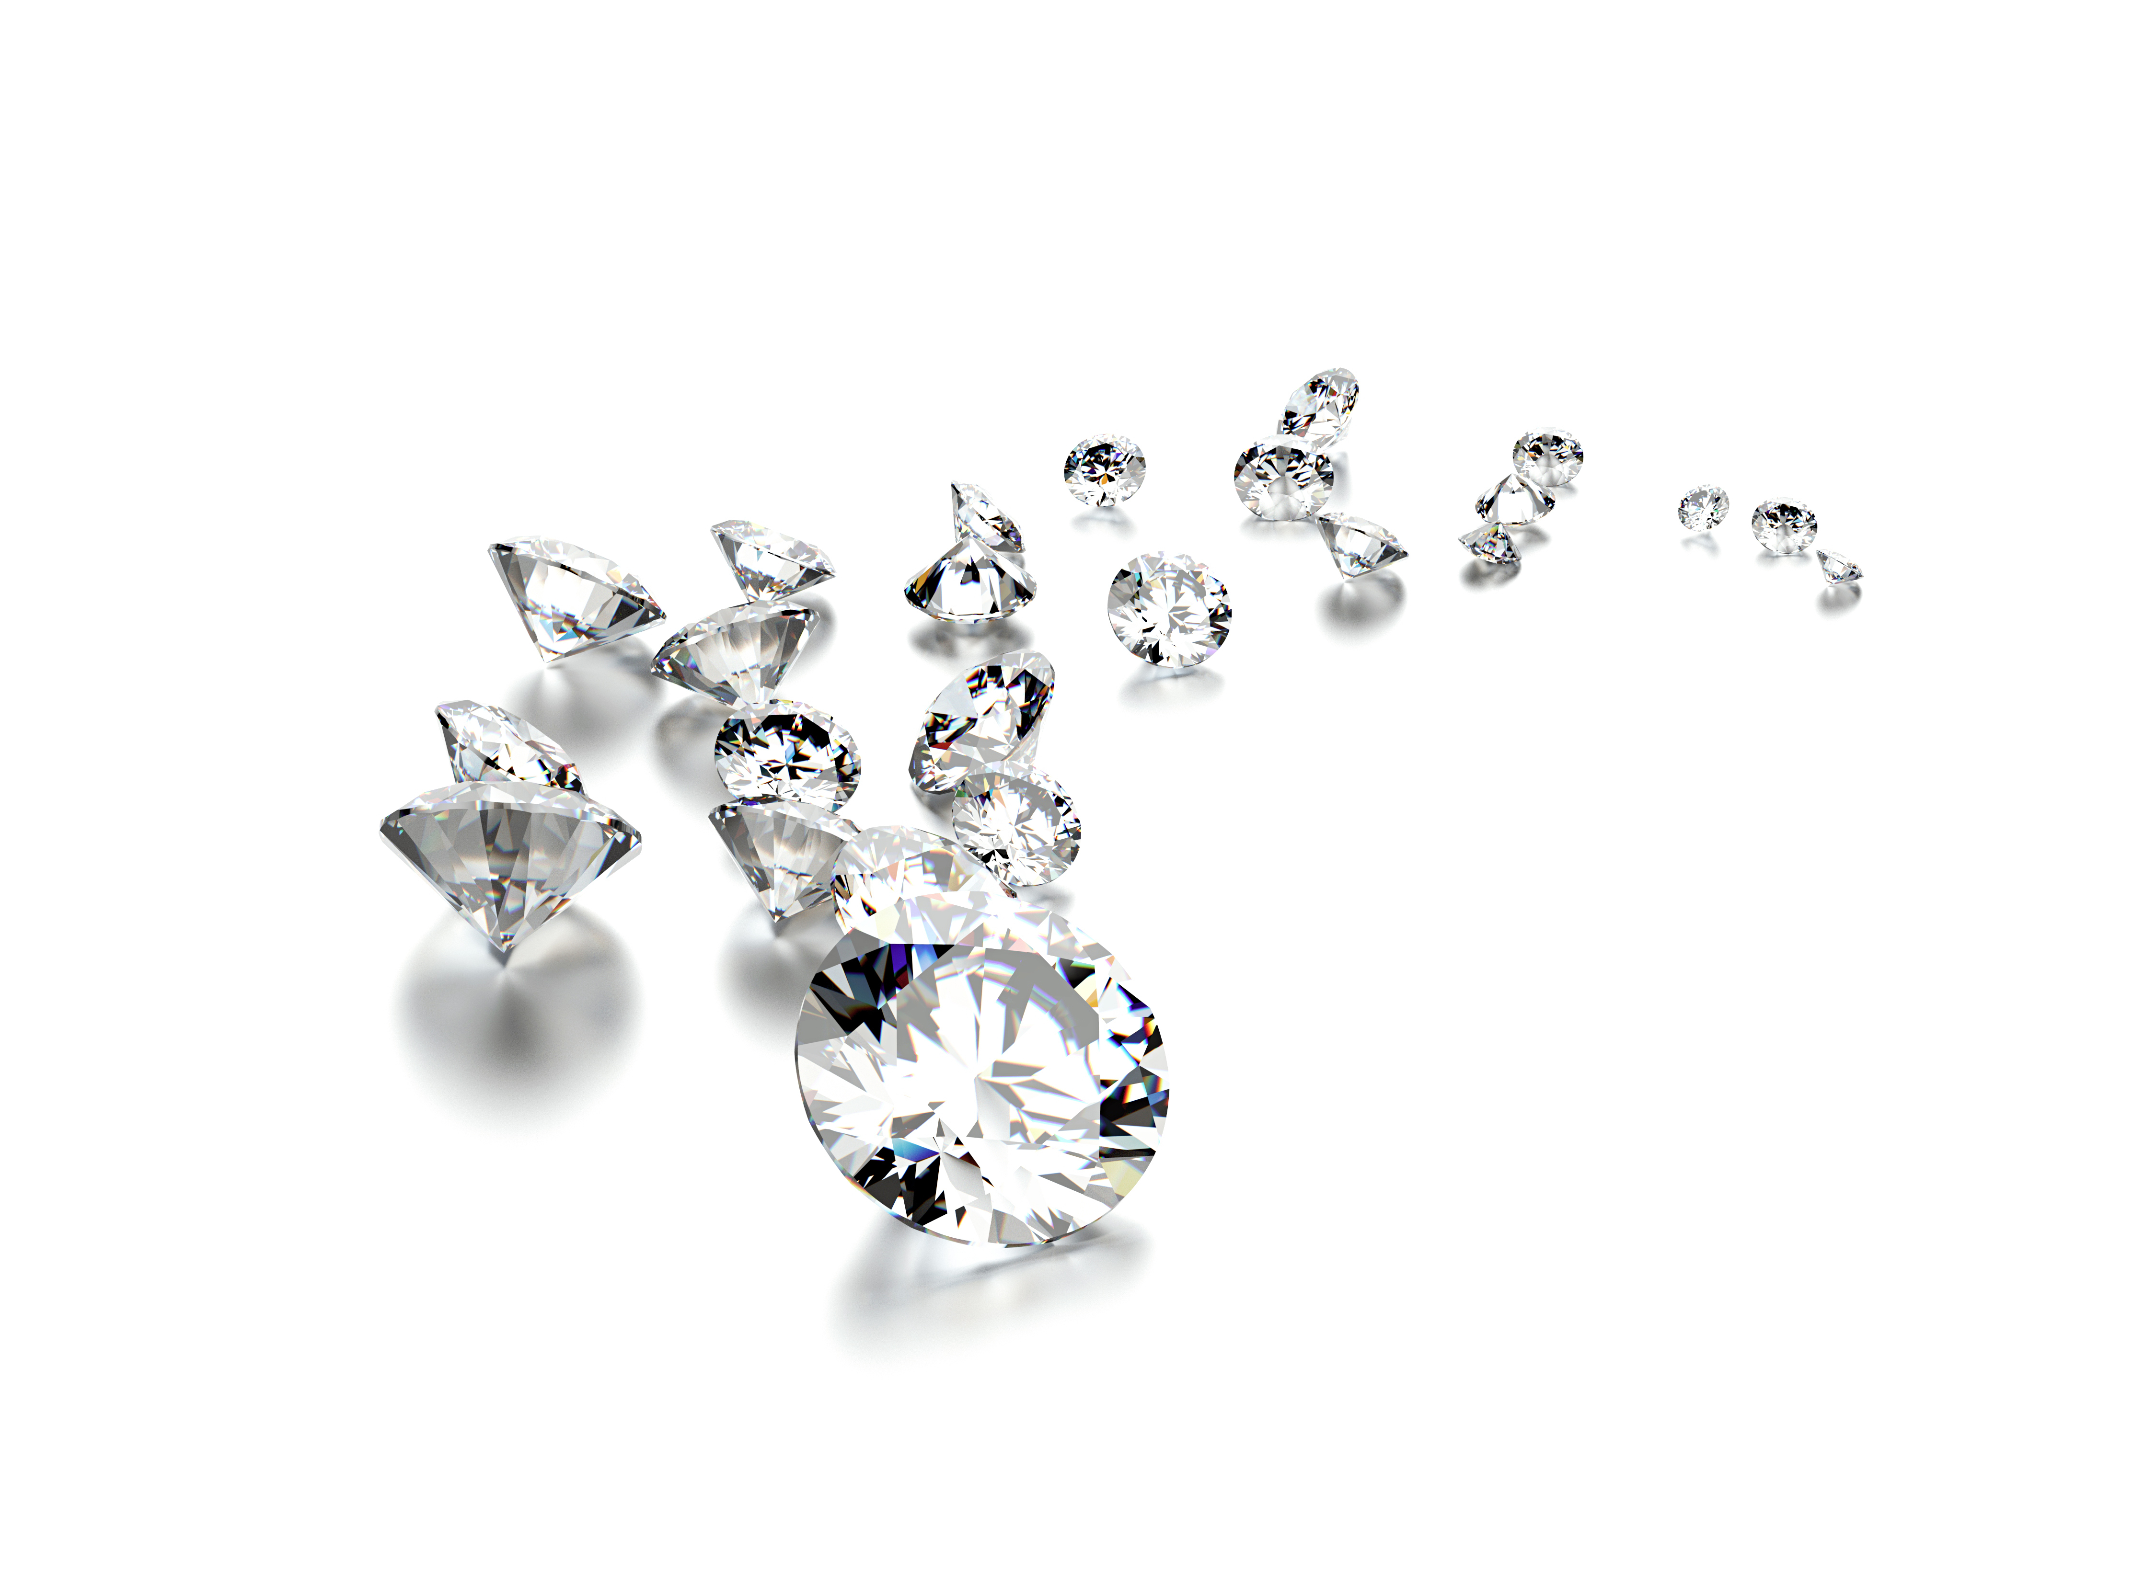

DIAMOND PRICE ANALYSIS & PREDICTION
You don’t need a diamond expert to tell you
How much your diamond worth
Done by Jeffery Chen

Slide 2
HYPOTHESIS OBJECTIVE OF THE PROJECT
The dataset consist of 53,940 pieces of diamond information, including price, 4Cs and other features.
Using this data to build a Machine Learning (ML) Model that will predict how much of any diamond worth.
Target audients are diamond lovers, diamond dealers or diamond buyers

Slide 3

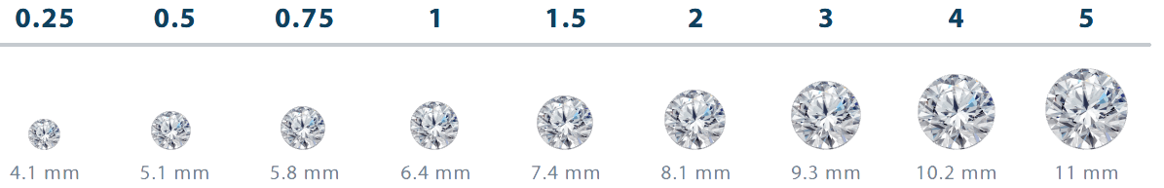
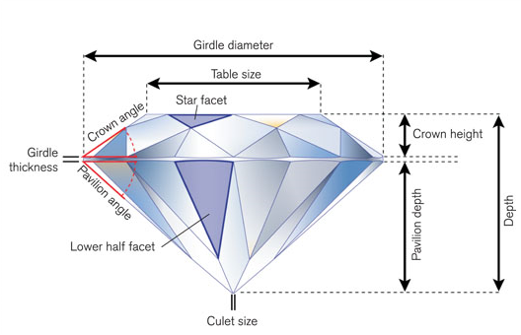
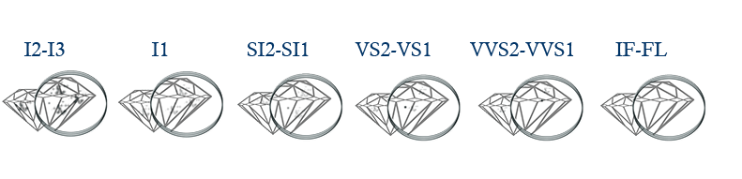
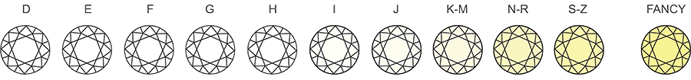
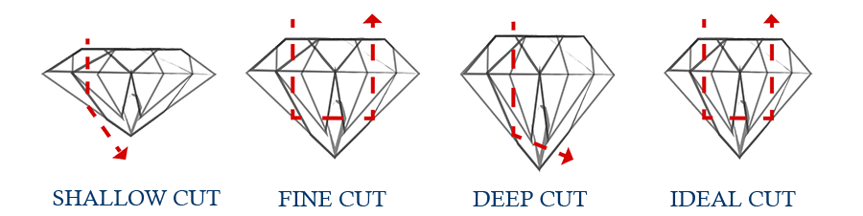
DIAMOND INTRODUCTION
4C
Carat
Clarity
Color
Cut

Slide 4

PROCESS WORKFLOW
DATA SEARCH
PROCESS WORKFLOW
EXPLORATORY DATA ANALYSIS (EDA)
https://www.kaggle.com/shivam2503/diamonds
MODEL CONSTRUCTION
FINAL MODEL IMPROVEMENT

Slide 5
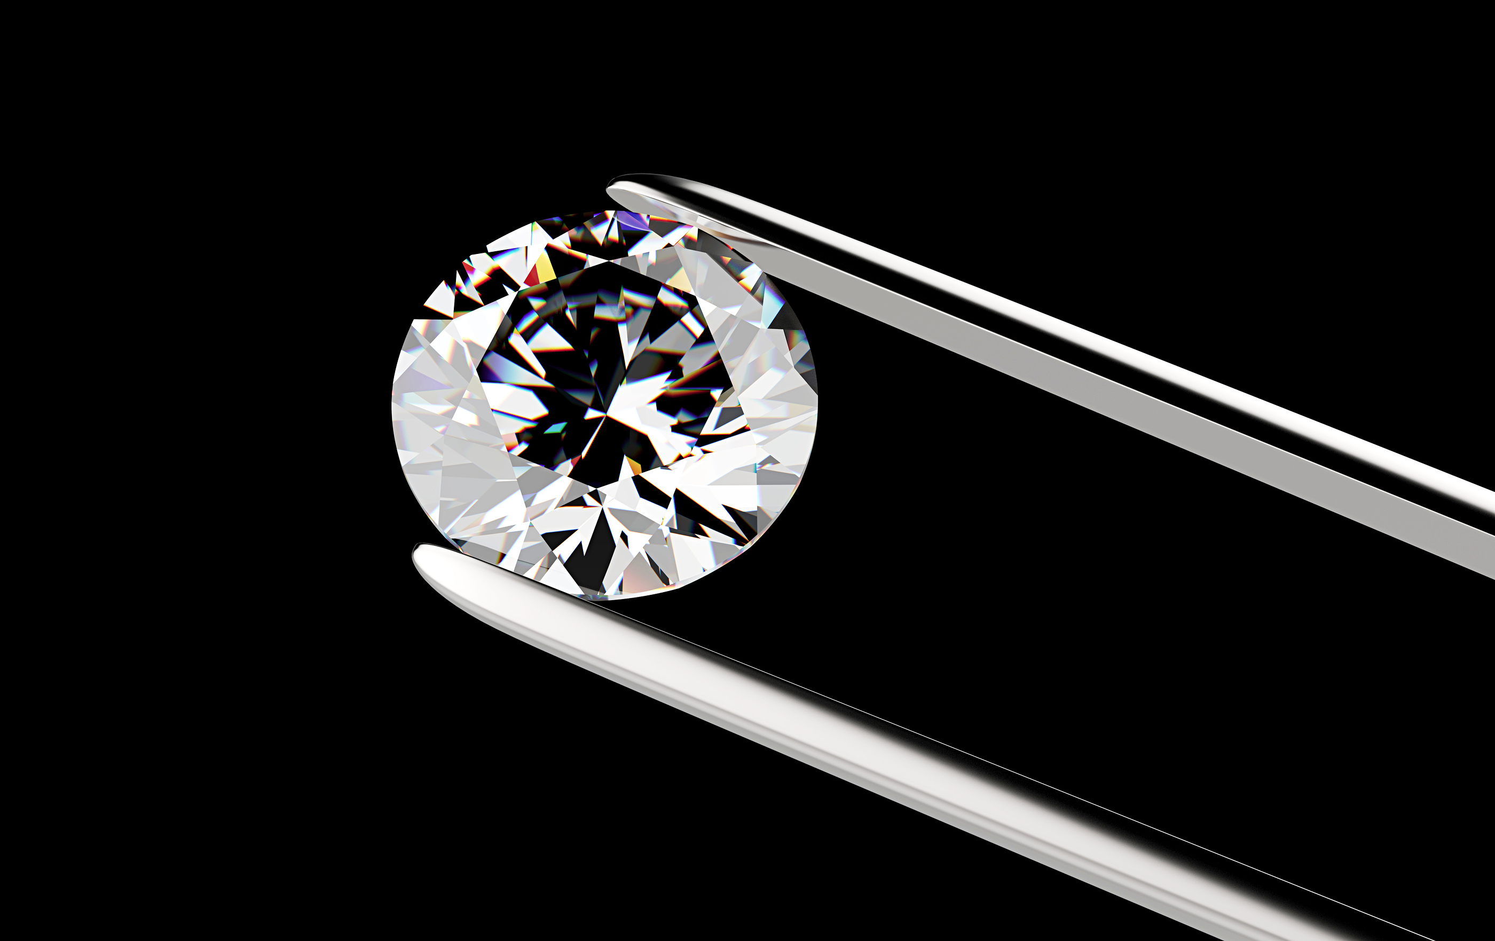
DATASET CONTENT: 1. Price US dollars ($326 -- $18,823) 2. Carat weight of the diamond (0.2ct -- 5.01ct) 3. Cut quality of the cut, graded as “Fair, Good, Very Good, Premium, Ideal” 4. Color diamond color, from J (worst) to D (best) 5. Clarity measurement of how clear the diamond is (I1 (worst), SI2, SI1, VS2, VS1, VVS2, VVS1, IF (best)) 6. x length in mm (0--10.74) 7. y width in mm (0--58.9) 8. z depth in mm (0--31.8) 9. depth total depth percentage = z / mean(x, y) = 2 * z / (x + y) (43--79) 10. table width of top of diamond relative to widest point (43--95)
Sit Dolor Amet

Slide 6





DATA UNDERSTANDING
DATA PREPARATION
DATA CLEANING
DATA TRANSFORMATION
EDA
KDEPLOT
correlation matrix HEATMAP
BOXPLOT
VIOLINPLOT
PAIRPLOT
HISTOGRAM

Slide 7
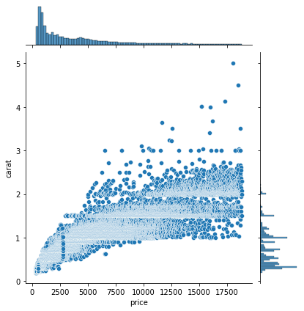
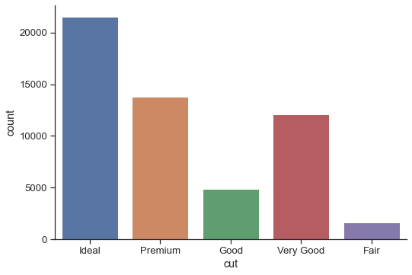
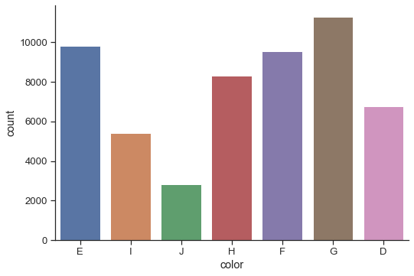
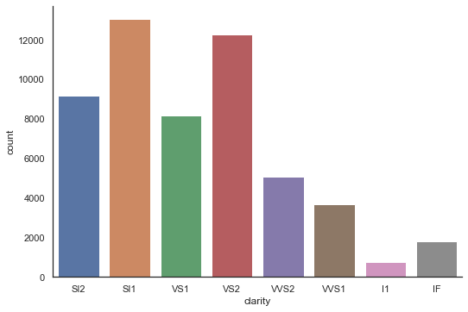
EDA – 4C DATA UNDERSTANDING
4C
Majority diamonds are ideal cut, premium cut and very good cut.
High percentage of diamonds with good color (DEFG)
Carat and Price are strongly positively correlated
SI and VS clarity have bigger percentage

Slide 8
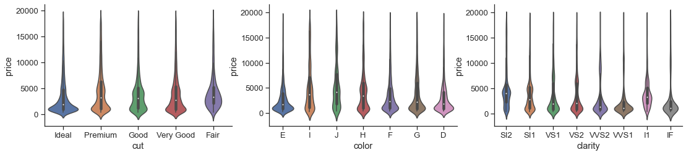
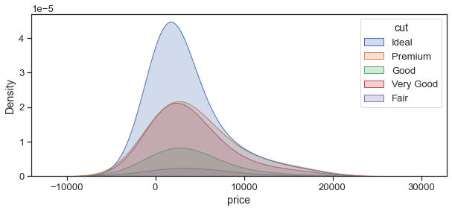
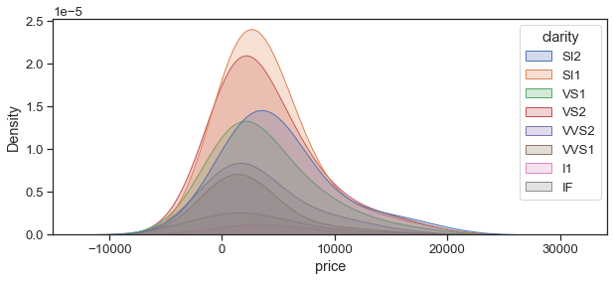
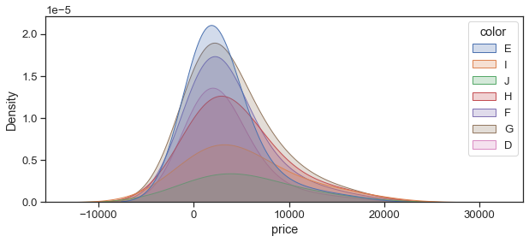
EDA – kdeplot & violinplot
SEABORN

Slide 9
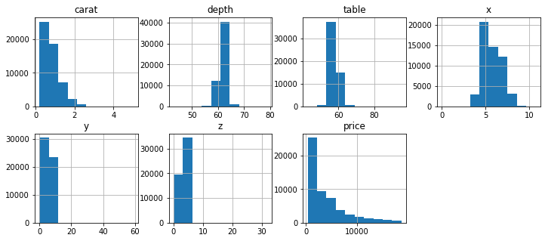

EDA – HISTOGRAM PLOT
PANDAS
Values distributed in the histogram are largely varied, standardization will be necessary

Slide 10
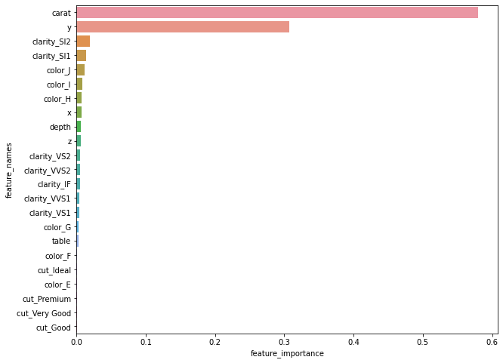

FEATURE IMPORTANCE
Weight and width are two most important features to predict diamond price!

Slide 11
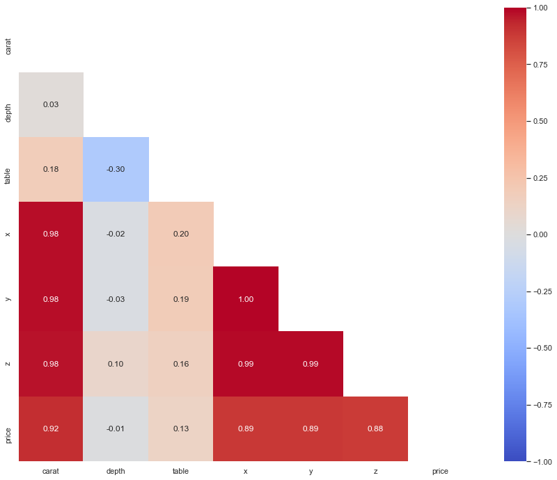
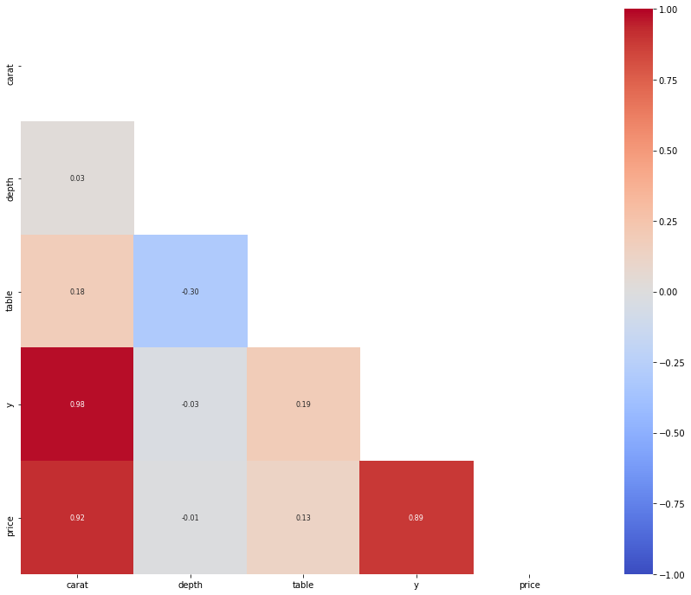


EDA –FEATURES SELECTION
correlation matrix HEATMAP
Length, width and depth are highly correlated with price, but seems redundant to keep all. We can choose to keep just one – width.
Boost Model Performance

Slide 12
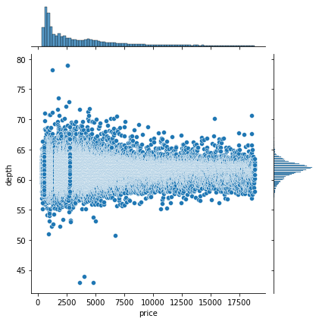
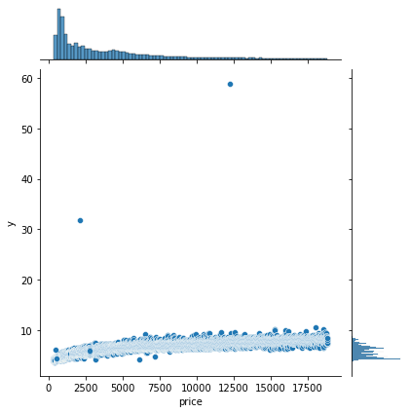
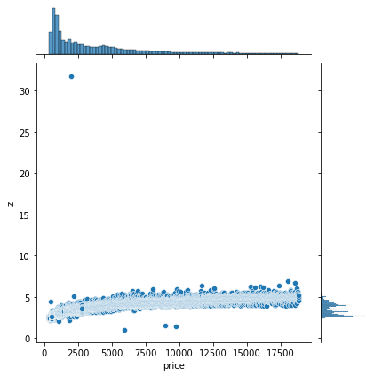
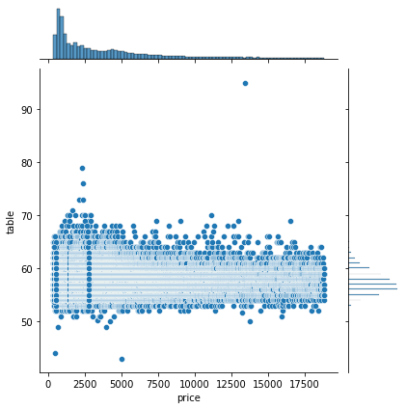
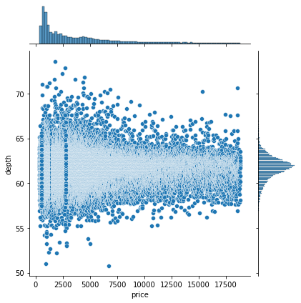
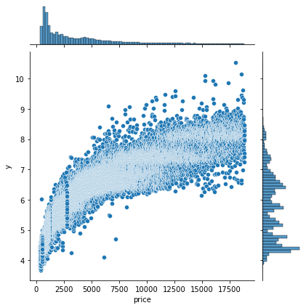
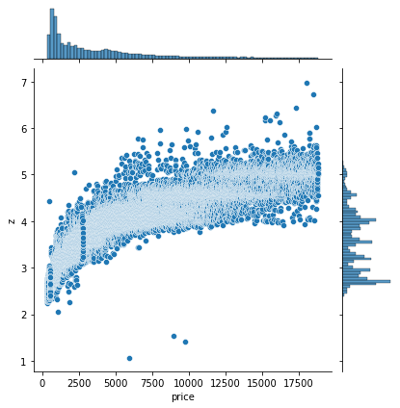
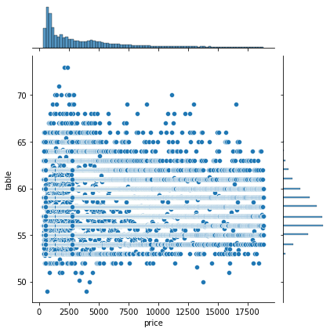
OUTLIERS
JOINTPLOT
Outliers occurred may due to human errors
Affect prediction results and assumptions
Removing them help improve ML performance

Slide 13
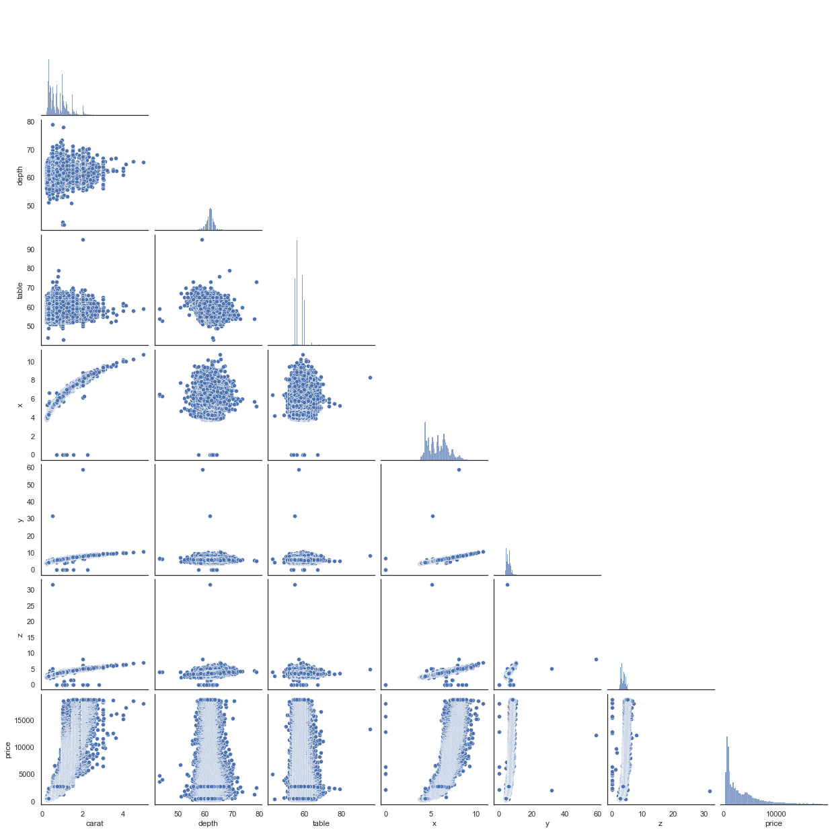
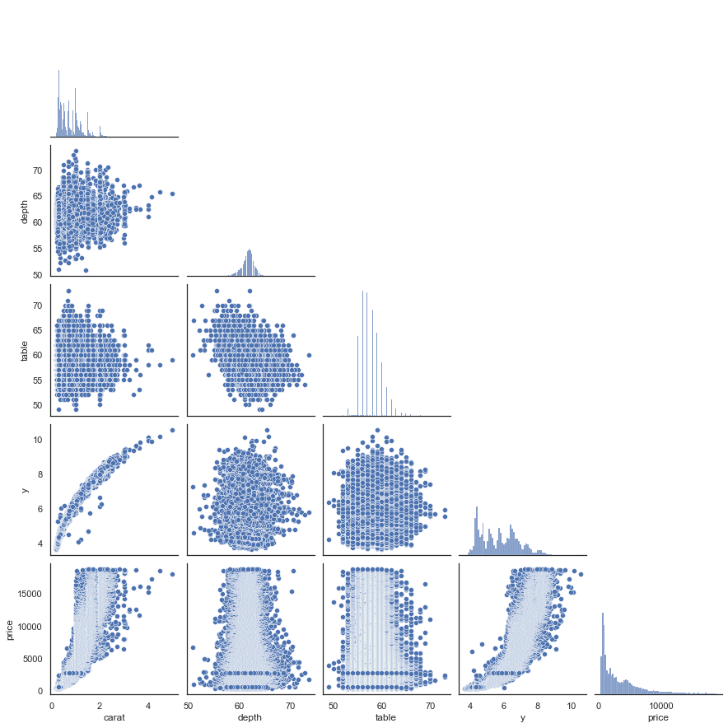
FEATURE ENGINEERING BOOST MODEL PERFORMANCE

Slide 14
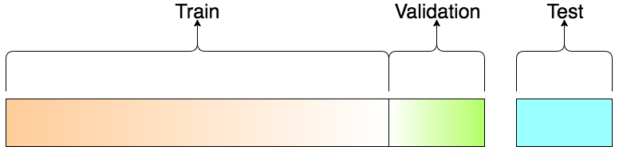
MODEL CONSTRUCTION
CROSS VALIDATION
CV 5
70%
30%
Baseline Model: Linear Regression()
Models:
K-Nearest Neighbor Regressor
MLP Regressor (Neural Network)
Decision Tree Regressor
Random Forest Regressor
Metrics: r2 score

Slide 15
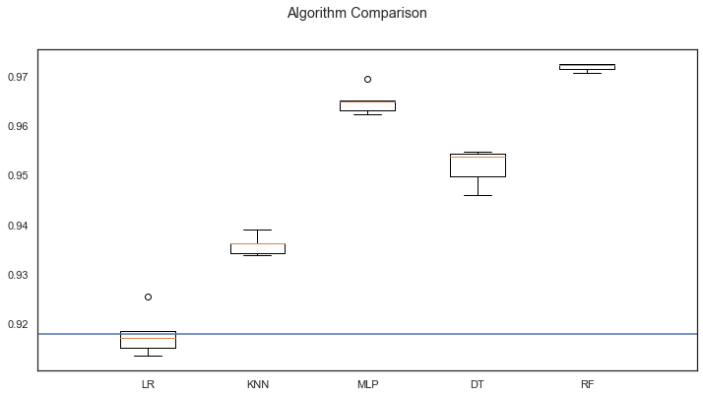


MODEL SELECTION (RANDOM FOREST)
r2
Can we still improve?
We found the best ML model, Random Forest, with r2 score 97%, running time 38 seconds

Slide 16
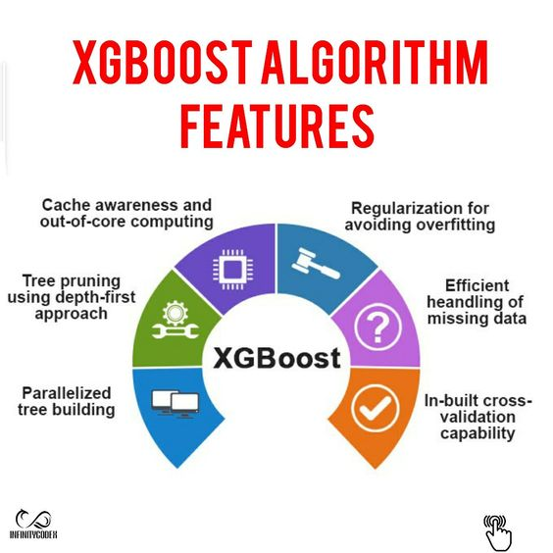

XGBoost
XGBoost (eXtreme Gradient Boosting)
Not only an algorithm
But entire Open Source Library
Implementation of the Gradient Boosting framework
Better in speed, flexibility, and model performances
https://in.pinterest.com/pin/605452743655932092/

Slide 17
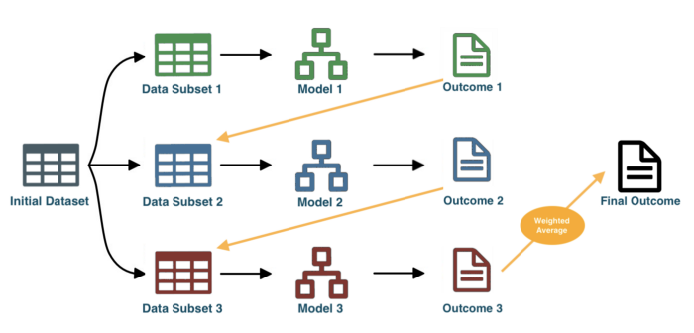
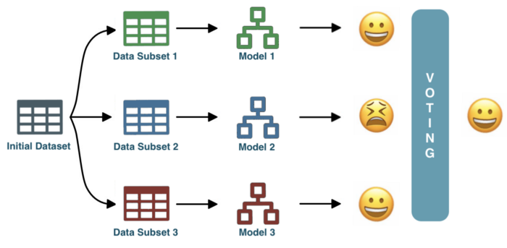
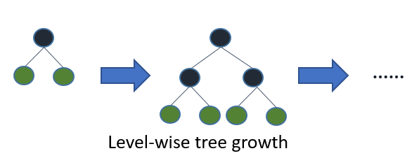
DIFFERENCE BETWEEN RF & XGB
eXtreme Gradient Boosting:
errors made by previous models be corrected by succeeding models
by adding some weights to the models machine learning algorithms
RF is an Ensemble Learning Algorithm
Bagging method
majority-vote strategy

Slide 18
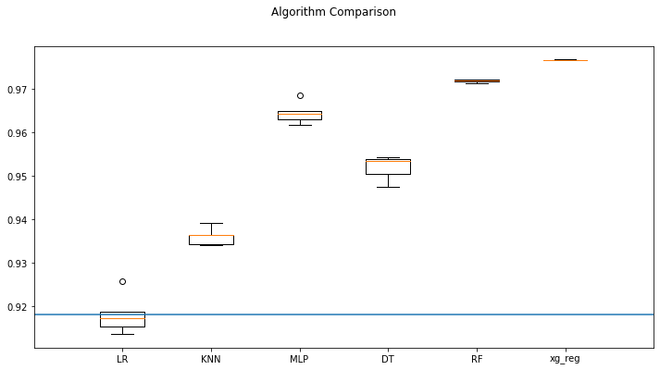
XGBoost MODEL EVALUTION
Finally found a better ML model, XGboost, with r2 score 98%, running time only 5.58 seconds
5.58s
98%

Slide 19
HYPERPARAMETERS TUNING
Hyperparameters:
- Tree Depth: 3, 6, 10
- Learning_rate: 0.01, 0.05, 0.1
- n estimators: 100, 500, 1000,
- colsample bytree: 0.3, 0.7
- seed = 20)
- GridSearchCV
- scoring = ‘neg_mean_squared_error'
Best parameters:
Tree depth: 6
Learning rate: 0.05
N estimators: 1000
Colsample bytree: 0.7
Lowest RMSE: 572.89
Find the best estimator
Finally we tune the best model !!!
Original RMSE: 842.68

Slide 20
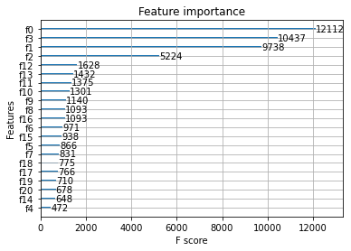
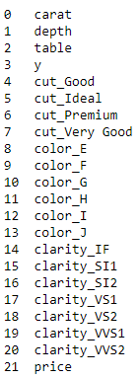
XGB FEATURE IMPORTANCE
F0 (Carat) and f3(width) still the 2 most important features
Another 2 important features f1 (table %) and f2 (Depth %)

Slide 21
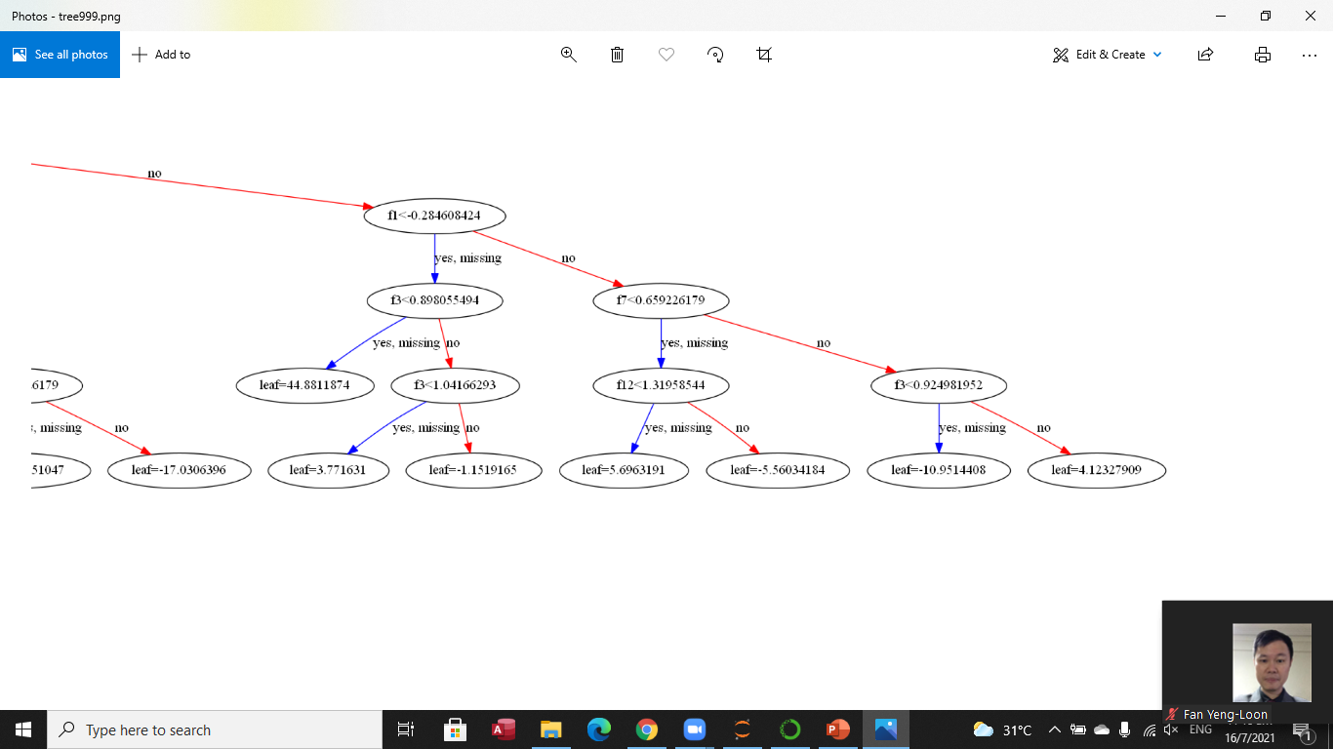
XGB TREE ANALYSIS
TREE #999

Slide 22
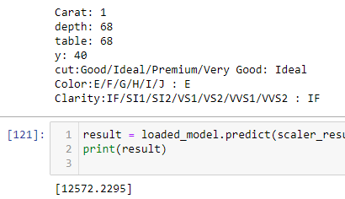
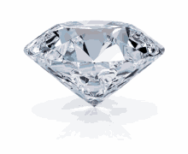
MODEL TESTING AND CONCLUSION
Machine Learning Model able to predict quite an accurate result of a good quality diamond
XGBoost is the best model to predict diamond price
Carat (weight) is the most important feature to determine a diamond value
Y value(width), table and depth are some other important features

Slide 23

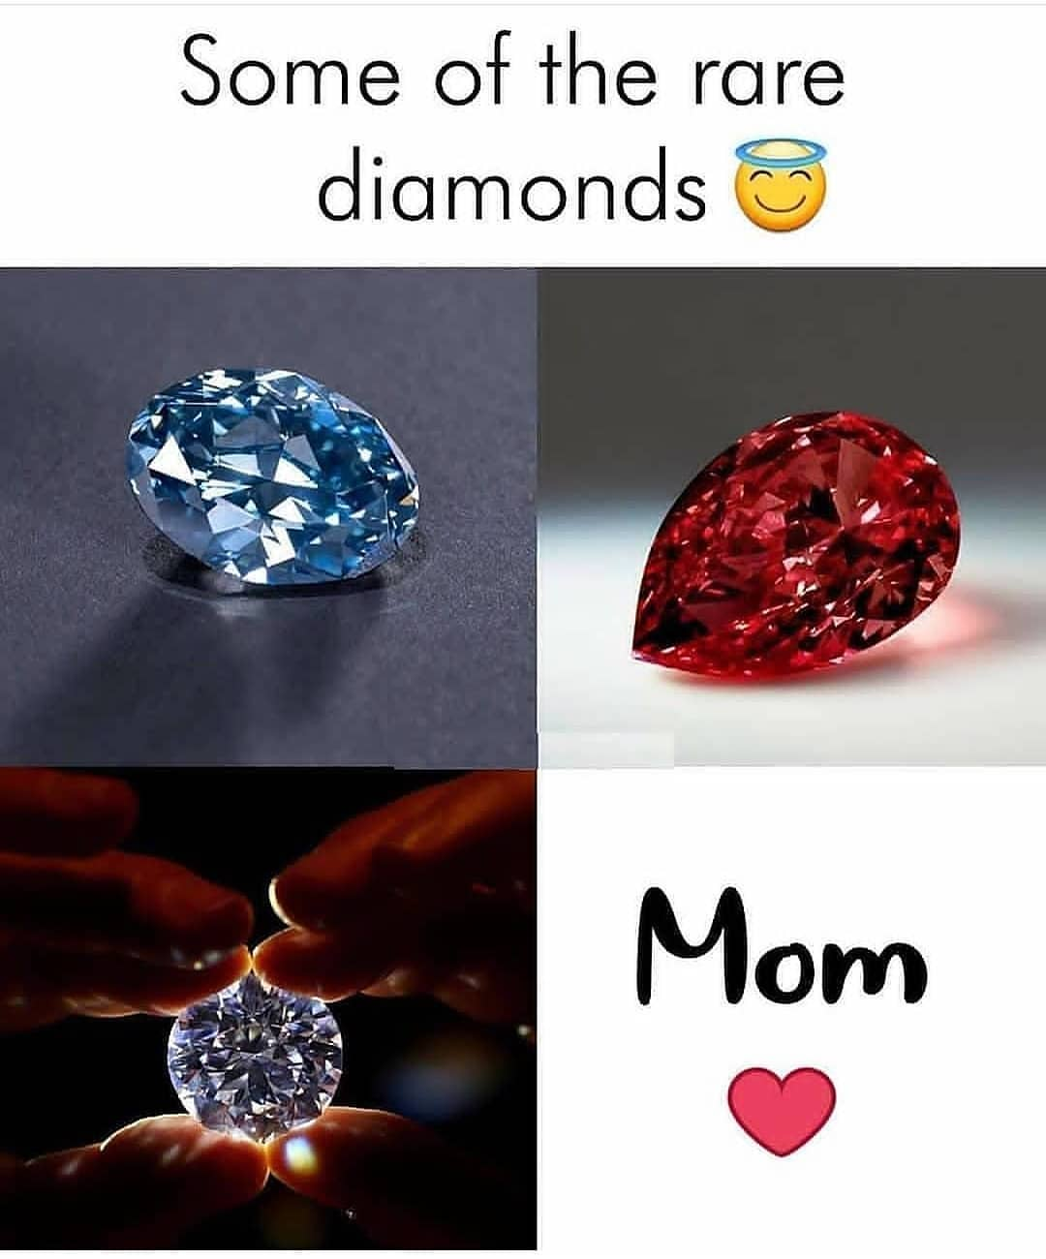
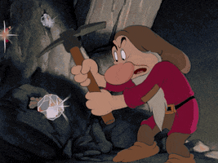
FUTURE OPPORTUNITIES AND APPENDIX
Future Opportunities:
Gather more data on different quality diamond to build a more robust model
Build a deep learning model
Create a website that help people with diamond price search and compare
Appendix
https://www.kaggle.com/shivam2503/diamonds
https://towardsdatascience.com/xgboost-fine-tune-and-optimize-your-model-23d996fab663

